Slide 1

CISC 250 –
Business Telecomm Networks
Course Introduction
Dr. Jinwei Cao
Dept. of ACCT & MIS
University of Delaware
CISC 250 Class Notes

Slide 2
Let’s know each other ☺
CISC 250 Class Notes

Slide 3


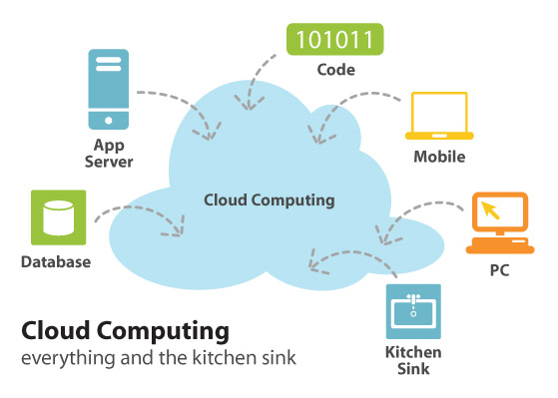



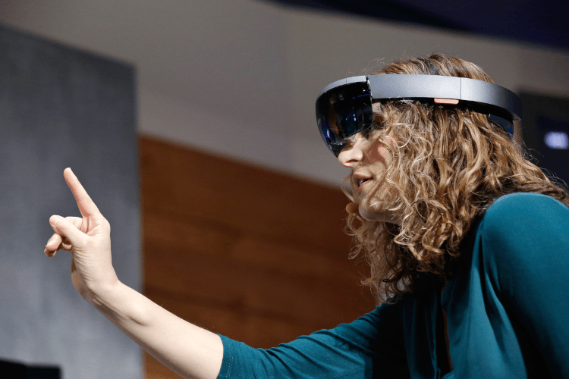



The Network is the Computer!
CISC 250 Class Notes

Slide 4

What will you learn from this course?
A practical understanding of the technical concepts and principles used in the design and implementation of data communications systems.
  How and Why
  Observe and Analyze
A practical business perspective on how data communications technology can provide organizations with a competitive advantage in the marketplace.
  Benefits of certain technologies
CISC 250 Class Notes

Slide 5
What will you not learn from this course?
Network administration
Algorithms
Programming
…
CISC 250 Class Notes

Slide 6
My expectations and policies
Let’s look at the syllabus…
The final project!
  YouTube Playlists
    2014
    2013
    2012
    2011
    2010
CISC 250 Class Notes

Slide 7

Your expectations …?
CISC 250 Class Notes

Slide 8
Now…
Let’s have some fun!
Warriors of The Net
CISC 250 Class Notes

